Slide 1

"Periodic Hospital Resource and Patient Monitoring System"

Slide 2


Project Leadership
Bharani Kumar Deepuru
CEO & Founder @ AiSPRY , 360DigiTMG | Chairperson AI For ITS India
https://www.linkedin.com/in/bharanikumardepuru

Slide 3
Team Members
www.linkedin.com/in/Vanity URL name
ANUSHREE
(48) Anu Shree | LinkedIn

Slide 4

Contents
Business objective
Business Constraints
Project Architecture
Data collection and details
Exploratory Data Analysis
Visualization
Modeling
Evaluation
Deployment
Notes:
Change

Slide 5
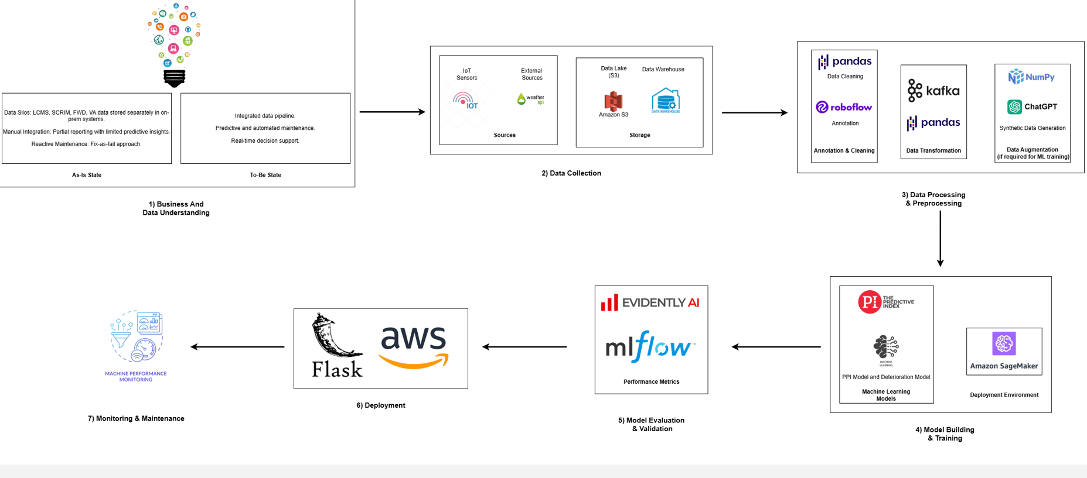
Project Overview and Scope

Slide 6
Business Problem
Business Constraints
Lack of Real-Time Patient Monitoring
Delayed health insights lead to slower medical response and poor patient outcomes.
Uncoordinated Equipment Usage
Medical, lab, and ambulance equipment are not optimally tracked or maintained.
Inefficient Data Collection
Manual or inconsistent data entry creates errors and delays in treatment decisions.
Limited Resource Planning
Hospitals struggle to predict demand and allocate resources effectively.
Inadequate Emergency Readiness
Lack of synchronized data affects ambulance and emergency service response times.
No Direct API Integrations: The hospital equipment is not advanced enough to support API-based data extraction. USB-Based Data Transfer: Data must be manually extracted from medical devices using USB storage devices. Data Security & Compliance: Patient and hospital data must be stored securely, ensuring compliance with healthcare regulations . Limited Automation: Due to non-digitized equipment, data ingestion may require manual intervention to transfer data from USBs to the SQL database. Scalability Considerations: The system must be designed to handle increasing volumes of medical and patient data over time.

Slide 7
CRISP-ML(Q) Methodology
There are six stages of CRISP-ML(Q) Methodology
1.Business and data understanding
2.Data preparation
3.model building
4.Model evaluation
5.Model deployment
6.Monitoring and maintenance

Slide 8
Technical Stacks
Data storage
Data cleaning
Data analysis
Data visualization
Optional: automation, deployment, or reporting

Slide 9
Data Collection and Understanding
Source:
The dataset was obtained from a hospital’s monitoring system and medical devices. It includes multiple measurements for different patients such as:
Temperature
Humidity
Oxygen concentration
Infusion volumes and pressures
Ventilator statistics
Collection Method:
Data appears to be collected via interconnected biomedical devices such as:
Incubators
Syringe Pumps
Infusion Pumps
Ventilators
File Structure:
Format: .xlsx (Excel Workbook)
Columns: 18+
Rows: Multiple (depends on patient monitoring entries)
Column Name | Description
Patient ID | Unique identifier for each patient
Temperature (°C) | Body temperature
Humidity (%) | Surrounding air humidity
Oxygen concentration (%) | Oxygen level in the incubator or ventilator
Noise level (dB) | Environmental noise level
Light intensity (lux) | Brightness in the room or incubator
Flow rate (mL/hr) | Speed of fluid delivery via syringe/infusion pump
Volume infused (mL) | Total fluid infused
Occlusion pressure (mmHg) | Pressure indicating blockage in the pump system
Battery level (%) | Device power level
Alarm status | Whether device alarm is triggered
Volume to be infused (mL) | Amount of fluid yet to be infused
Time remaining | Time left for infusion completion

Slide 10
Data Information
Sheet: patients record
Contains patient demographic and clinical data, including:
Patient ID, Name, Age (in days), Gender, DOB
Illness, Date of Admission
Birth & Admission Weight, Height
Symptoms, Vital Signs, Allergies
Doctor details, Room Type,
Insurance Emergency contact, Address
2. Sheet :medical equipment
Tracks use of various medical devices
NICU, PICU, etc
.NICU Ventilator: Respiratory rate, tidal volume, FiO2, PEEP
NICU Incubator: Air temp, humidity, skin temp
PICU Ventilator, Suction Device, Defibrillator, ECG machine

Slide 11
3. Sheet :laboratory equipment
Lab test results from various analyzers:
Hematology: Hemoglobin, WBC, Platelets
Biochemistry: Glucose, Urea, Creatinine
Immunoassay: TSH, Vitamin D, CRP
Urine Analysis: pH, Specific Gravity, Protein
Example Entry (P0001):
  Hemoglobin: 16.66 g/dL, WBC: 7.85, Platelets: 376.78
  Glucose: 75.3 mg/dL, Creatinine: 1.15
  TSH: 3.76, Vitamin D: 23.16, Protein: Trace
. Sheet: ambulance records
Ambient conditions: Temperature, Humidity, Oxygen levels
Noise & Light levels
Syringe Pump: Flow rate, Volume infused, Occlusion pressure
Infusion Pump: Battery, Alarm, Volume remaining
Ventilator: Respiratory rate, Tidal volume, FiO2, PEEP
Example Entry (PID1001):
  Temp: 37.2°C, Humidity: 58%, Oxygen: 24%
  Flow rate: 43 mL/hr, Ventilator FiO2: 47%

Slide 12
Data Dictionary
Sheet: patients record
Sheet: medical equipment
Column Name | Data Type | Description / Sample
Patient ID | object | Unique patient identifier
Name | object | Patient's full name
Age (days) | int64 | Age in days
Gender | object | Male / Female
DOB | datetime64[ns] | Date of birth
Illness | object | Diagnosis (e.g., Flu, Asthma)
Date of Admission | datetime64[ns] | Admission date
Birth Weight (kg) | float64 | Weight at birth
Admission Weight (kg) | float64 | Weight at admission
Height (m) | float64 | Height in meters
BMI | float64 | Body Mass Index
Discharge Weight (kg) | float64 | Weight at discharge
Blood Group | object | e.g., AB-, A+
Patient Ward No | object | Ward number
Symptom | object | Key symptom on record
Vital Signs | object | Composite string (e.g., BP, RR, SpO2)
Allergies | object | Known allergies
Total Amount (₹) | float64 | Billing total
Doctor Assigned | object | Doctor name
Doctor Assigned.1 | object | Redundant doctor field
Room Type | object | General / Private
Insurance | object | Yes / No
Emergency Contact | int64 | Emergency phone number
Address | object | Full address
Equipment Group | Measured Parameters (examples)
NICU - Ventilator | Respiratory Rate, Tidal Volume, FiO2, PEEP
NICU - Incubator | Air Temp, Humidity, Skin Temp
NICU - CPAP Machine | Pressure, Flow Rate
PICU - Monitor | Heart Rate, SpO2, BP
PICU - Infusion Pump | Flow Rate, Volume Infused, Drug Conc.
PICU - Ventilator | Tidal Volume, PEEP, FiO2
General - Suction Device | Pressure, Duration
General - Defibrillator | Energy Level, Shock Count
General - ECG Machine | Heart Rate, QT Interval

Slide 13
Sheet: ambulance records
Sheet: laboratory equipments
Category | Parameters
General Vitals | Temperature, Humidity, O₂, Noise, Light
Incubators | Temp & Humidity settings
Syringe Pump | Flow Rate, Volume, Occlusion Pressure
Infusion Pump | Volume to be infused, Time left
Ventilator | Respiratory Rate, Tidal Volume, FiO₂, PEEP
Equipment | Test Parameters
Hematology Analyzer | Hemoglobin, WBC, Platelets
Biochemistry Analyzer | Glucose, Urea, Creatinine
Immunoassay Analyzer | TSH, Vitamin D, CRP
Urine Analyzer | pH, Specific Gravity, Protein

Slide 14
System Requirements
1. Software Requirements
Operating System: Windows 10 or higher / macOS 10.15 or higher
Tools Required:
  Microsoft Excel (2016 or later)
  Python (Anaconda, Jupyter Notebook) or R (optional)
  Power BI / Tableau (for visualization)
  MS PowerPoint (for creating presentation)
. Hardware Requirements
Processor: Intel i5 or higher / AMD Ryzen 5 or better
RAM: Minimum 8 GB (Recommended: 16 GB for faster processing)
Storage: At least 1 GB free space (for dataset, tools, and outputs)
Graphics: Integrated graphics is sufficient for data analysis; GPU is optional
. Dataset Characteristics
Format: Excel (.xlsx)
Size: ~58 KB (small dataset, easy to process)
Number of Sheets: 1
Data Types:
  Numeric (e.g., temperature, flow rate)
  Categorical (e.g., alarm status)
  Temporal (time-based values if any)

Slide 15
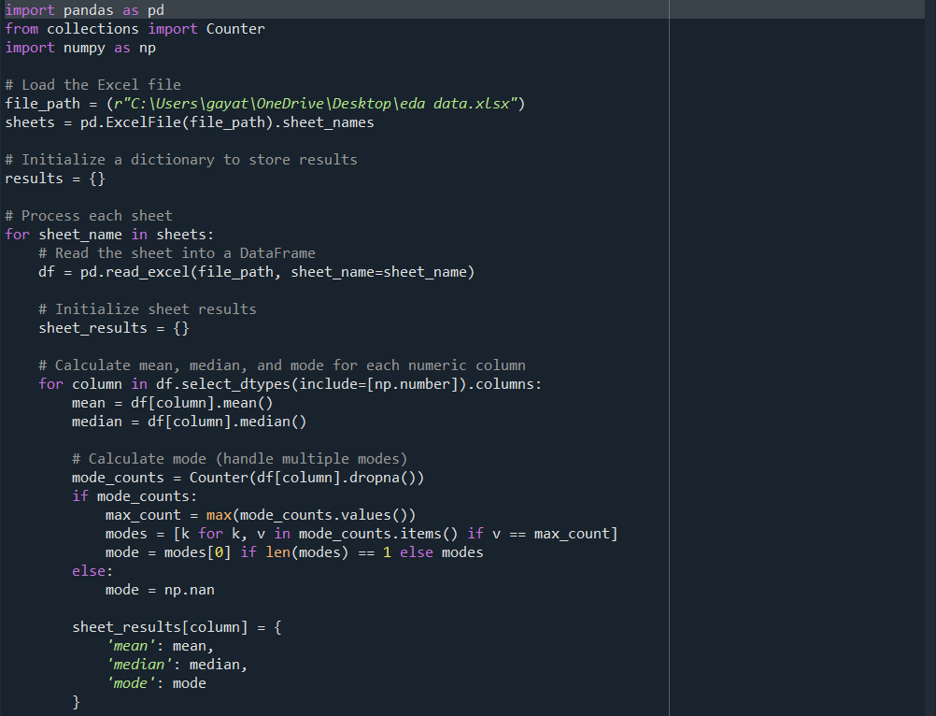
Exploratory Data Analysis [EDA]
Notes:
EDA is used for seeing what the data can tell us before the modeling task.
Change

Slide 16
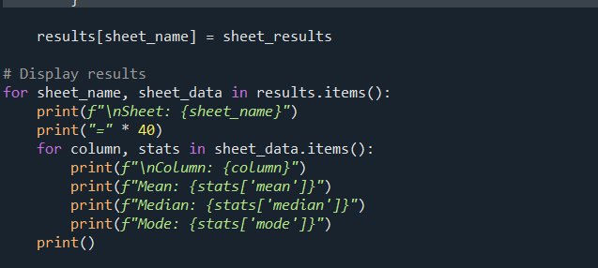

Slide 17
Missing Values Observation
# Count missing values per column
missing_values = df.isnull().sum()
# Add missing value info to results
missing_info = {}
for column in df.columns:
missing_info[column] = {
'missing_count': missing_values[column],
'missing_percentage': (missing_values[column] / len(df)) * 100
}
# Optionally print missing values
print(f"\nMissing Values in Sheet: {sheet_name}")
print("-" * 40)
for column, info in missing_info.items():
print(f"{column}: {info['missing_count']} missing ({info['missing_percentage']:.2f}%)")

Slide 18
Data Preprocessing
Handling missing values
Data type conversion
Removing duplicates
Outlier detection
Feature encoding
Normalization or scaling
Final dataset preview
Notes:
Keep observations

Slide 19
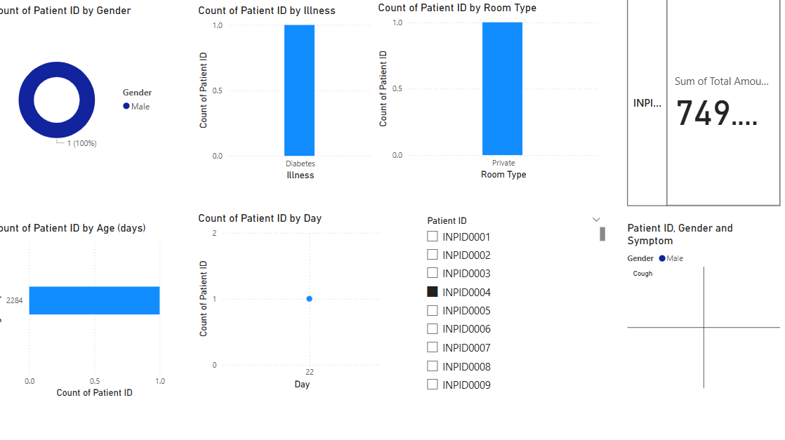
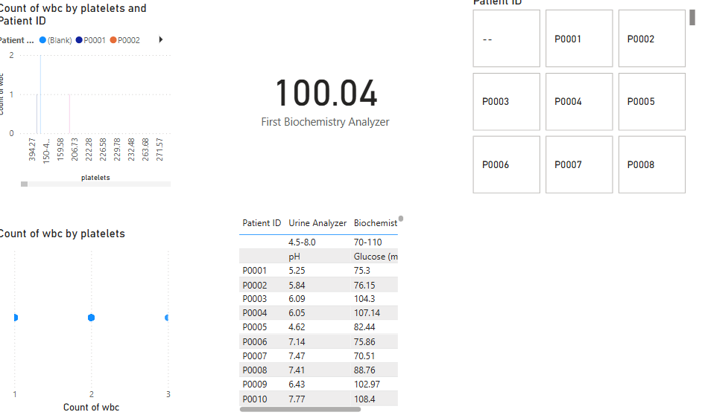
Data Visualization
Notes:
Add graphical

Slide 20
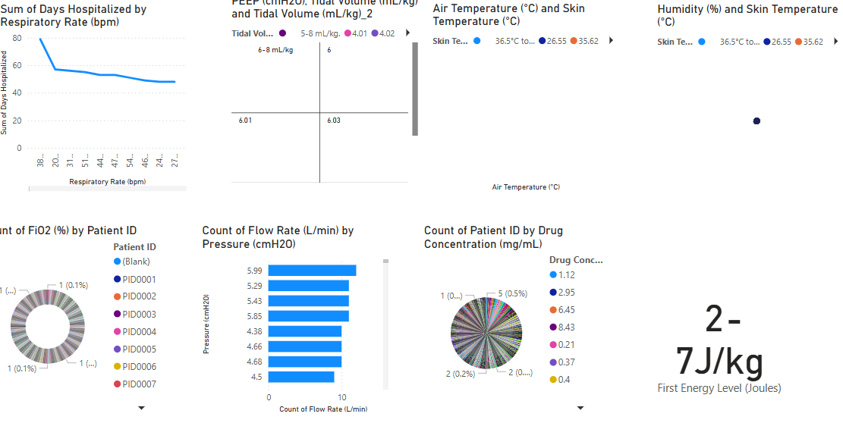
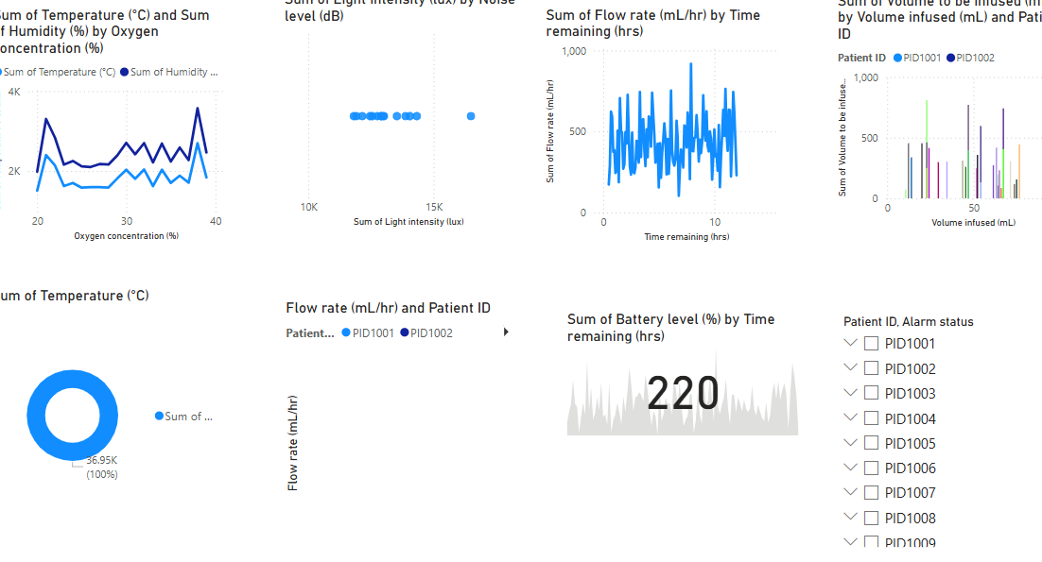

Slide 21
Model Building
Data Collection
Data Preprocessing
Exploratory Data Analysis
Feature Engineering
Model Selection
Model Evaluation
Deployment
Monitoring & Feedback
Model Training
Notes:
classification is the task of predicting a discrete class label. Regression is the task of predicting a continuous quantity.
What is classification techniques in machine learning?
The Classification algorithm is a Supervised Learning technique that is used to identify the category of new observations on the basis of training data. In Classification, a program learns from the given dataset or observations and then classifies new observation into several classes or groups.
What is regression techniques in machine learning?
Regression is a technique for investigating the relationship between independent variables or features and a dependent variable or outcome. It's used as a method for predictive modeling in machine learning, in which an algorithm is used to predict continuous outcomes.

Slide 22
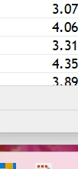
Screen shot of output

Slide 23
Challenges
Complexity Across Sheets
Data Visualization Challenges
Interpretation & Insight Extraction
Redundant or Duplicated Columns
Missing Metadata
Data Alignment

Slide 24
Future Scopes
. Predictive Healthcare Analytics
Use historical data to predict patient deterioration.
Early warning systems can be built using machine learning models.
Potential to reduce ICU burden through predictive interventions.
2. Integration with Real-Time IoT Devices
Real-time data from devices like ventilators and syringe pumps can be integrated.
Enables dynamic dashboards for continuous patient monitoring.
Supports development of smart ICU systems.
3. Improved Hospital Resource Management
Analysis can help optimize equipment usage (e.g., ventilators, infusion pumps).
Aid in planning for future resource allocation and procurement.
4. Clinical Decision Support Systems
Derive clinical rules and thresholds (e.g., for alarms, oxygen levels).
Empower clinicians with data-backed decisions at bedside.
5. Patient Safety & Risk Management
Identify patterns that indicate potential risks (e.g., high occlusion pressure).
Improve alarm management systems and reduce false alarms.
6. Research and Development
This dataset can be used for clinical research, especially in ICU settings.
Potential to contribute to AI models in biomedical research.
7. Personalized Treatment Plans
Insights can help create customized care protocols based on patient vitals and equipment usage.

Slide 25

Queries ?
How many guests visited during each period (daily/weekly/monthly)?
Which time periods show the highest number of visits?
What is the average duration of stay across periods?
Which services are most frequently availed by guests?

Slide 26


